Slide 1
Final Presentation
By: Kevin Hartanto, LyLy Nguyen,
Temi Jolaoso, Marilyne Kouassi,
& John Schueler

Slide 2
Business Questions:
Do all the variables we are analyzing increase or decrease in correlation from 2012 to 2015?
Do all the variables we are analyzing change proportionally in correlation from 2012 to 2015?
Hypothesis:
We hypothesize that the variables of quality of education, quality of faculty, and alumni employment of the Center of World University Rankings overall ranking algorithm increased in correlation proportionally from 2012 to 2015.
We arrived at this conclusion because we believe that the three variables that we choose an increase in correlation proportionally because we perceive that these variables have become increasingly crucial for student success in the 21st century.
Notes:
CWUR uses seven objective and robust indicators to rank the world's universities:
1) Quality of Education, measured by the number of a university's alumni who have won major academic distinctions relative to the university's size (25%)
2) Alumni Employment, measured by the number of a university's alumni who have held top executive positions at the world's largest companies relative to the university's size (25%)
3) Quality of Faculty, measured by the number of faculty members who have won major academic distinctions (10%)
4) Research Performance:
i) Research Output, measured by the the total number of research papers (10%)
ii) High-Quality Publications, measured by the number of research papers appearing in top-tier journals (10%)
iii) Influence, measured by the number of research papers appearing in highly-influential journals (10%)
iv) Citations, measured by the number of highly-cited research papers (10%)

Slide 3
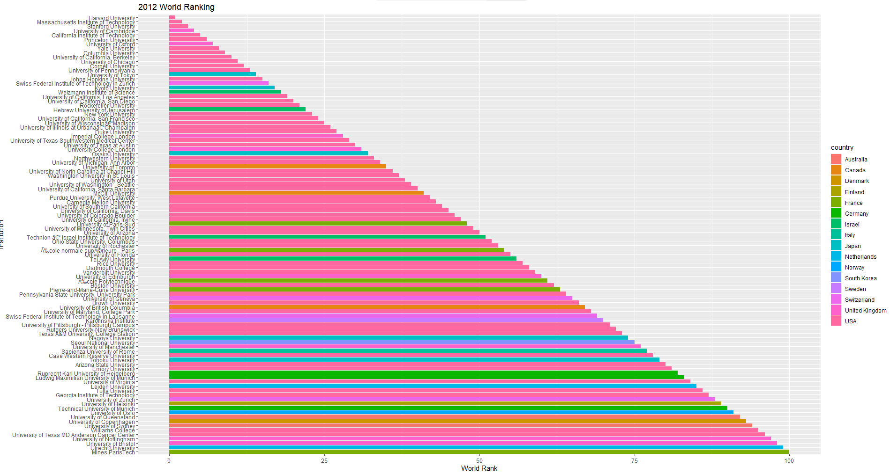
2012 World Ranking Top 100

Slide 4
2012 world ranking
58% of the world’s top 100 institutions are located in the United States.
The remaining 42% is composed of 15 other countries.
The top three institutions were all American institutions.
American institutions dominate the overall World Rank for the top 100 in 2012.
Picture from previous slide
(Picture from previous slide)
Notes:
The smaller the bar plot the better of ranking

Slide 5
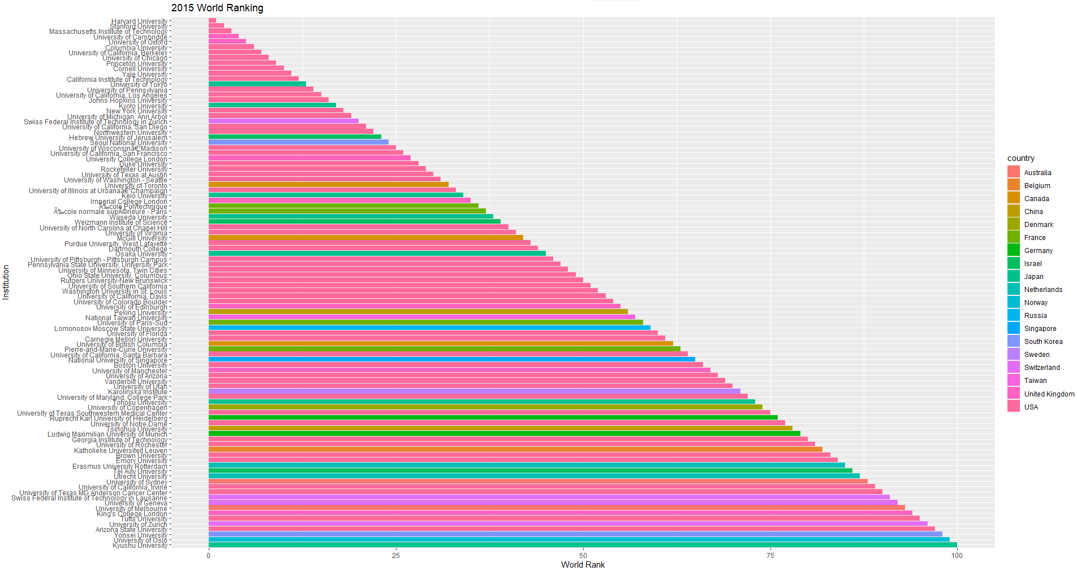
2015 World Ranking Top 100

Slide 6
2015 world ranking
55% of the top 100 institutions were in the USA.
Harvard, MIT, and Stanford remained the top 3 institutions.
Institutions from Italy and Finland were not in the top 100 institutions World Rank.
Belgium, China, Russia, Singapore, and Taiwan were in the top 100 institutions ranking.
As technology advanced, globalization progressed, and the development of the economy for many countries, more international institutions were ranked in the top 100 by the overall World Ranking algorithm.
(Picture from previous slide)

Slide 7
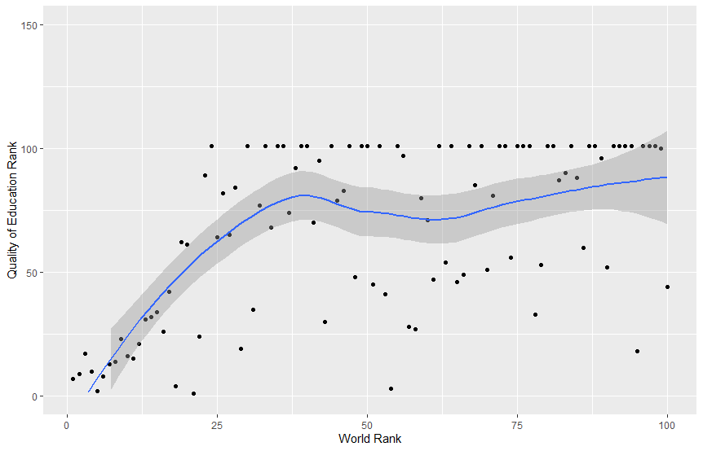
2012 Quality of Education
The overall Quality of Education is largely nonlinear.
The nonlinear regression model features few dots near or next to it within the top 20.
Many institutions outside of the top 20 either have a very high or low rank of quality of education in contrast to the average suggested by the nonlinear regression model.
The correlation number is 0.563944
Any points below the nonlinear regression model are of higher ranks than its institution World Rank. Hence, the Quality of Education for these institutions helped them get higher in the World Ranks.
Notes:
Quality of Education, measured by the number of a university's alumni who have won major academic distinctions relative to the university's size (25%)
The regression line represents the institution world rank for 2012 starting at 1st to 40th.
The bar graph represents the rank of quality of education according to the university’s alumni (Bachelor, Master, or Doctoral degrees) who have won major awards, medals, and prizes. The higher the bar, the lower the rank.
The quality of education determines 25% of the university’s world rank.
The overall quality of education is largely nonlinear.
The nonlinear regression model features few dots near or next to it within the top 20.
Many universities outside of the top 20 either have a very high or low rank of quality of education in contrast to the average suggested by the nonlinear regression model.
The correlation number is 0.563944
Any points below the nonlinear regression line are of higher ranks than its institution world rank. Hence, the quality of education for these institution helped it get its world rank placement.

Slide 8
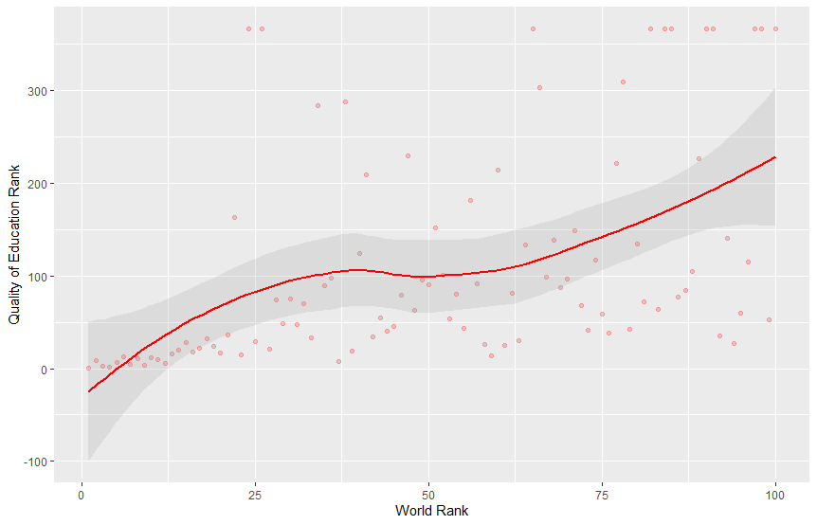
2015 Quality of Education
In 2015, many more institutions outside of the top 20 overall rankings were near proximity to the nonlinear regression model.
The correlation number is 0.4741671
Outliers exist, though not as many as in 2012.
Most of the Quality of Education for the top 100 institutions is of higher rank than its World Rank, but a few data points rank a lot lower than 100. Hence, the correlation number is smaller than in 2012.
According to the correlation number, the Quality of Education rankings are more closely correlated to the World Rank in 2012 than in 2015.
Notes:
The overall plot represents the quality of education of a university based on the academic future of its alumni.
In 2015, according to the graph, Harvard is still ranked 1st for institution world rank. It was also ranked 1st for quality of education.
This tells us that Harvard’s quality of education meets the entire 25% of their overall world rank.
You can see that Northwestern University, Seoul National University, University of California - SF, Keio University, and Wasda University quality of education ranks a lot lower than their world ranks. This tells us that their ranks are better determined by other factors, hence, how they were able to get top 40 for world rank institutions.

Slide 9
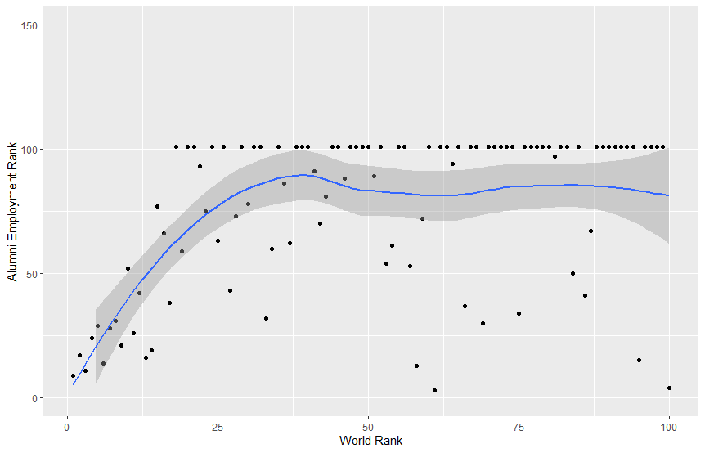
2012 Alumni Employment
The nonlinear regression model visually resembles an exponential curve.
There were many data points with the value 101 on the y-axis because 101 was the lowest possible score. All of the institutions that were not ranked in the top 100 for alumni employment received the rank of 101.
The correlation number is 0.4182789
The plot shows that there is a moderately strong correlation between the Alumni Employment and the World Rank of institutions.
The decrease from 2012 to 2015 indicates that the relationship between Alumni Employment and the Worldwide Rank has become relatively weak because higher education was becoming increasingly accessible.
Notes:
Alumni Employment, This indicator measures the weighted average number (per year) of a university’s alumni who have held CEO positions since 2011 at the world’s top 2000 public companies relative to the university’s size.The top companies are listed on the Forbes Global 2000 list.

Slide 10
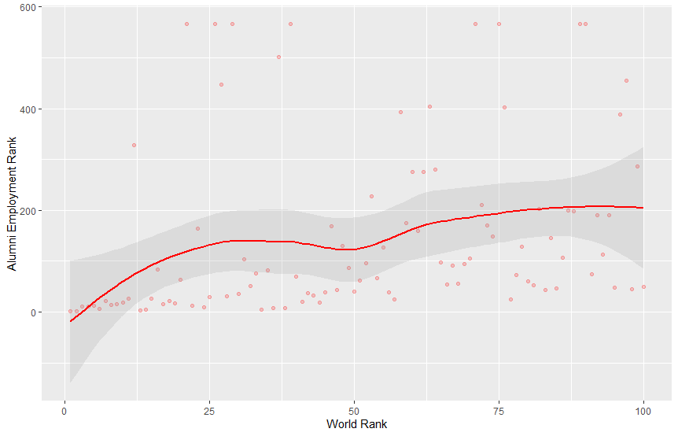
2015 Alumni Employment
In 2015, significantly more top 100 ranked institutions are plotted further from the nonlinear regression model.
The correlation number is 0.2869522
The plot shows a decrease in correlation from 2012.
The decrease from 2012 to 2015 indicates that the relationship between Alumni Employment and the World Rank has become relatively weak because higher education were becoming increasingly more accessible.

Slide 11
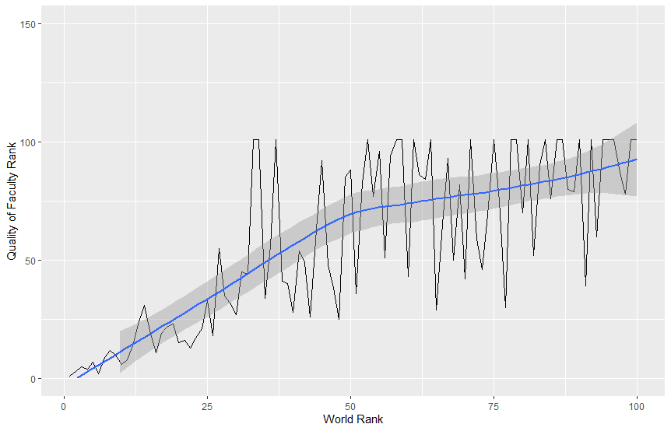
2012 Quality of Faculty
With the nonlinear regression model, the 2012 quality of faculty nearly has a straight line, but it has a little curve when the world rank is number 50.
The Correlation number is 0.7695974
There aren’t many huge outliers on this graph because most of the data points from the quality of faculty rank are closely related to the world rank.
The top 25 world institution rank shows that these institutions have won many medals, prizes, and awards because the world rank and quality of faculty rank have similar numbers.
To conclude, the 2012 quality of faculty rank is showing a strong positive correlation with the world rank
In 2012, it showed that the top 100 institutions have won many academics awards and show that professors in these institutions are passionate about making better education in the institutions.
Notes:
Quality of Faculty, measured by the number of faculty members who have won major academic distinctions (10%)

Slide 12
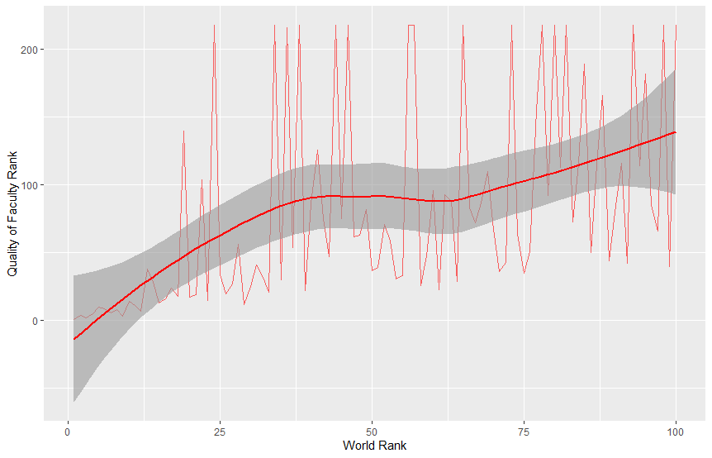
2015 Quality of Faculty
For the 2015 quality of faculty, the graph looks different because there are many data points with a huge outlier.
The outlier is showing after the world rank of number 10. The reason that there is a huge outlier because most of the top 100 institutions have a lower rank on the quality of faculty.
The top 10 institutions are consistent in their high ranking of quality of faculty.
The Correlation number is 0.4850297
In 2015, it shows that the correlation number decreased to a moderate strong positive correlation with the world rank.
We believe this because an increase in online resources for students has decreased the value of having high quality faculty for universities.
The top 100 institutions showed that many institutions were struggling to maintain the quality of faculty as time goes by.

Slide 13
Conclusion
Hypothesis:
We hypothesize that the variables of quality of education, quality of faculty, and alumni employment of the Center of World University Rankings overall ranking algorithm increased in correlation proportionally from 2012 to 2015.
Conclusion: FALSE
We determined upon the statistical analysis of multiple variables belonging to the ranking algorithm that each variable we analyzed decreased in correlation to the overall university ranking and each did so at a different rate; they did not change proportionately.
In a higher education market that has become increasingly digitally democratized, universities are less valued for their quality of education, quality of faculty, and alumni employment.

